Slide 1
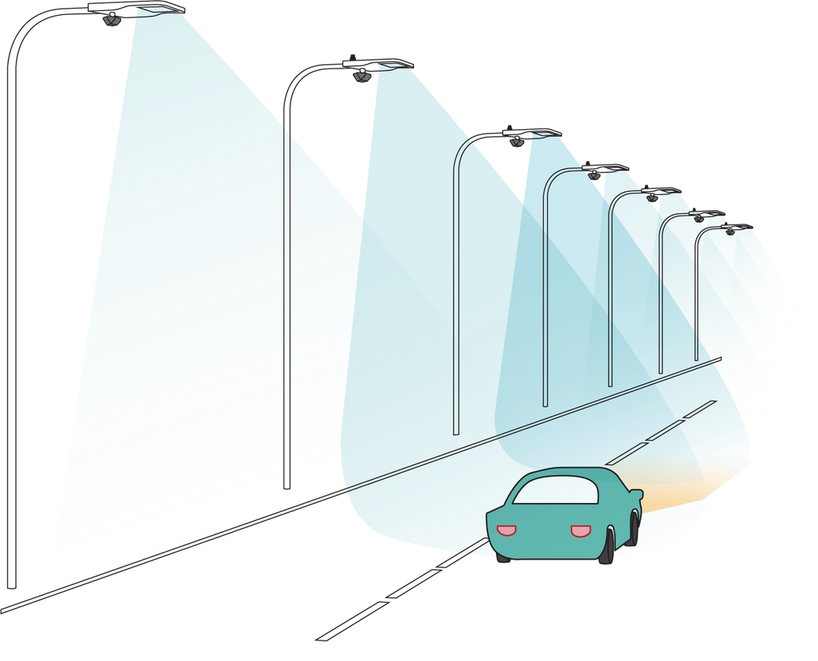
Smart Street Light System

Slide 2
Contents
Introduction
Existing systems
Problem Statement
Software and Hardware Requirements
Comparison between models
Results
Conclusion
Future Improvements

Slide 3
Introduction
The project is about controlling the intensity of street lights.
The intensity is increased or decreased based on the time of the day, the traffic and also on the fog in the atmosphere.
The program is written so that the lights turn off on its own when the sun rises.
The main focus of this project is to prevent wastage of electricity.
This project is a combination of hardware & software and it is also cost efficient.

Slide 4
Software Requirements
Hardware Requirements
Arduino board
LDR sensor
Rain sensor
IR sensor
LED lights (n0. 2)
Connecting wires
Computer
Arduino IDE

Slide 5
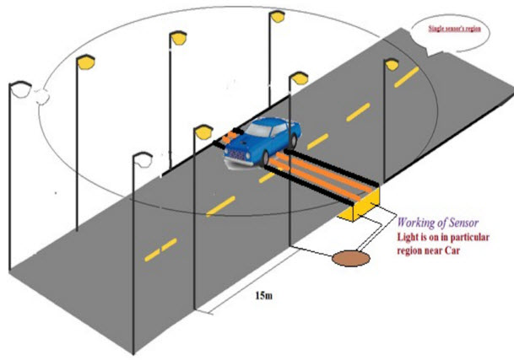
Working Principle

Slide 6
More saving of energy used in the street.
Safe road lighting for smooth vehicular movement lights.
Intelligent intensity control.
This idea can be implemented on both small roads and busy highways.
Street light glows on detecting vehicle movement project is inexpensive and costs effective.
Applications

Slide 7
CONCLUSION
The Smart Street Light System effectively demonstrates an intelligent solution to managing street lighting using sensors and automation.
By dynamically adjusting the light intensity based on traffic movement, ambient light, and weather conditions like fog or rain, the system significantly reduces energy consumption and enhances road safety.
Its cost-efficient design and ease of implementation make it a practical choice for both urban and rural environments.
This blend of hardware and software highlights how technology can be leveraged for sustainable infrastructure development, paving the way for smarter and greener cities.

